Slide 1


Building Better Programs for
Justice Involved Women
Presented by
Lisa Talbot Lundrigan, AdCare Criminal Justice Services, Inc.
Moderator, Stephen Keller
Training/TA Coordinator, RSAT-TTA

Slide 2
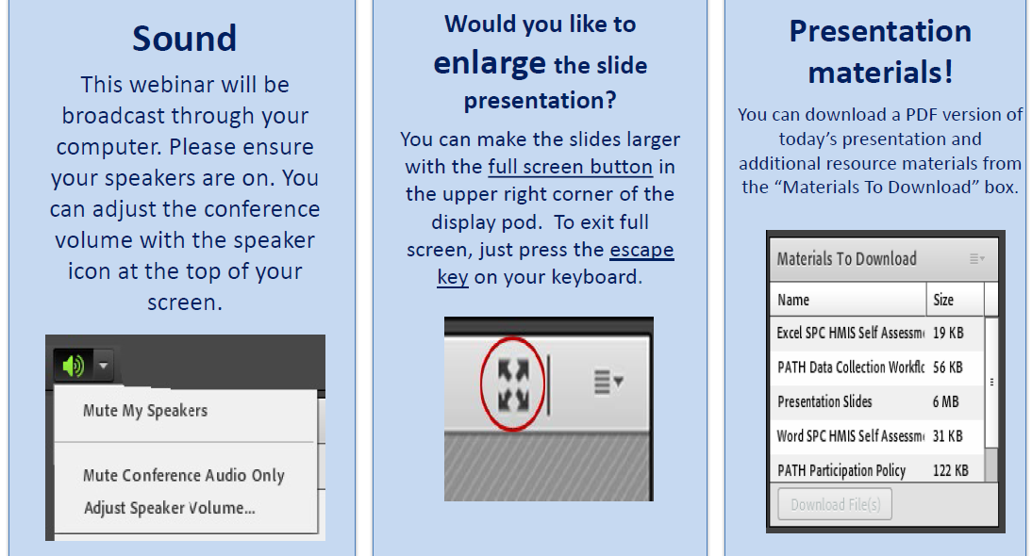
Housekeeping: Functions

Slide 3
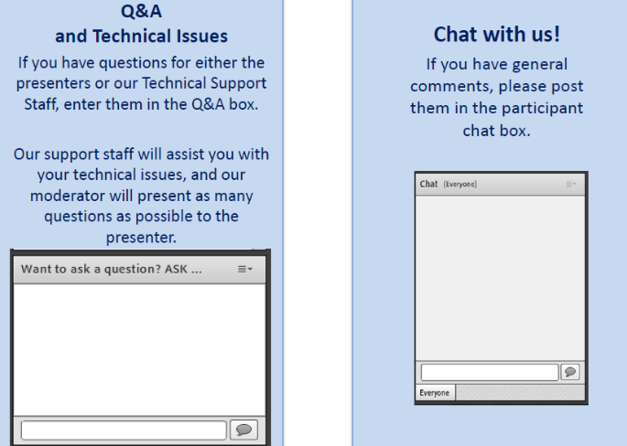
Housekeeping: Communication

Slide 4
Building Better Programs for
Justice Involved Women
Presented by
Lisa Talbot Lundrigan, AdCare Criminal Justice Services, Inc.
Moderator, Stephen Keller
Training/TA Coordinator, RSAT-TTA

Slide 5
RSAT Website
www.rsat-tta.com
Archived webinars and handouts
Articles and other publications
Research, references, and resources
Elearning curricula
Interactive forum

Slide 6
Objectives
After this event, participants will be able to:
Identify two ways standard risk/needs assessment is not a fully accurate reflection of women's risk level.
Identify at least one risk/needs assessment tool that is gender responsive.
Identify at least two need areas which data suggest are more prevalent for justice-involved women than for men.
Identify at least two trauma-informed approaches that can be implemented within the criminal justice system.
Identify at least two evidence-based resources for planning and implementing gender-responsive programs.

Slide 7
National Center for
Justice Involved Women
The Ten Truths explored in this presentation are found in the document Ten Truths That Matter When Working With Justice Involved Women
The NCJIW is a national clearinghouse of Information and Resources for Justice Involved Women
Partnership of the Bureau of Justice Assistance, the National Institute of Corrections and The Center for Effective Public Policy.
http://cjinvolvedwomen.org/

Slide 8
The Essex County Sheriff’s Department
Massachusetts
Located north of Boston
Houses male inmates in two distinct locations.
Operates three community corrections centers, all of which serve women.
Operates two Detox Units, one Male and one Female.
Operates the Women In Transition program to provide case management and GR program services to women entering the community.

Slide 9
Panelists from Essex County Sheriff’s Department Programs
Michelle Alsup, Essex County Regional Manager, AdCare Criminal Justice Services
Janine Belliti, Detox Program Director, ACJS
Tommie Bower, Women in Transition Program, Senior Clinician, ACJS

Slide 10
Truth One
Women are the fastest growing criminal justice population yet pose a lower public safety risk than men (NRCJIW, 2012; 2016)
  In 2013, there were 1.2 justice-involved women in the United States. (Glaze & Kaeble, 2014)
  In the past two decades the number of women who are justice involved has grown at a consistently greater rate than that of justice involved men.

Slide 11
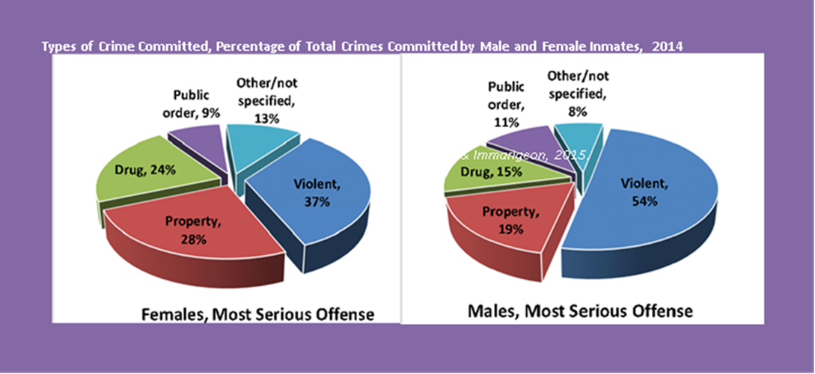
Types of Crimes Committed

Slide 12
Truth Two
Women Follow Unique Pathways into Crime and Present Risk Factors that Signal Different Intervention Needs (NCJIW, 2012; 2016)

Slide 13
Pathways Model
Women’s criminal activities are seen in the context of their live circumstances.
Convergence of the impact of women’s socioeconomic status, race, gender.
Co-Occurring Disorders
Impact of Trauma

Slide 14
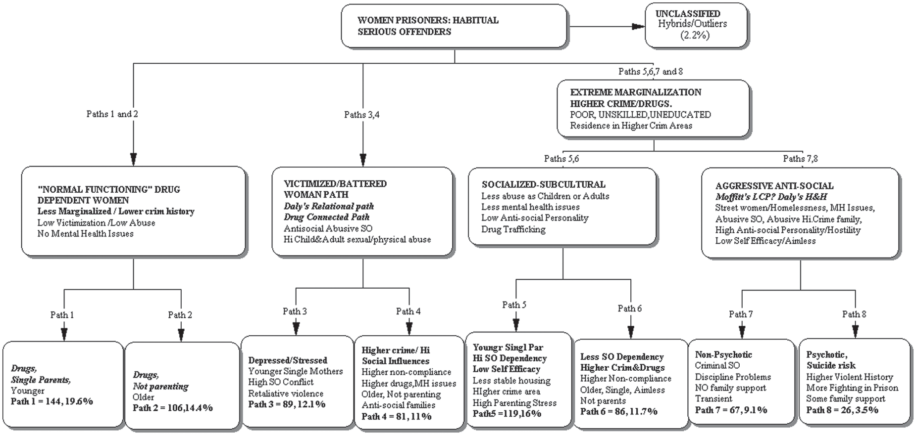
Pathways Model
Brennan, Breitenbach, Dieterich, Salisbury, van Voorhis (2012); Women’s Pathways to Serious and Habitual Crime

Slide 15
Truth Three
Women’s Engagement in Criminal Behavior is Often Related to their Relationships, Connections and Disconnections with Others
  Childhood relationships and dynamics
  Childhood Trauma
  Violent / Abusive Relationships
  Absent / Inconsistent connections
  Grief and Loss

Slide 16
Truth Four
Traditional Criminal Justice Policies and Practices Have Largely Been Developed Through the Lens of Managing Men, Not Women.
  Facilities built to house men.
  Staffed by Officers and other professionals trained in supervision of men
  Courts overwhelmingly sentence and supervise men.

Slide 17
Truth Five
Justice Involved Women Often Report Histories of Sexual Victimization and Trauma, and Continue to be Vulnerable within Corrections Settings.
  Despite training and advances including PREA, the correctional institution remains and unsafe and triggering environment.

Slide 18
Trauma and Justice Involved Women
  Women who are justice involved are more likely to have experienced chronic trauma than women who are not justice involved, than men who are justice involved, and men who are not justice involved.
  Further, the type of trauma they experience tends to be: more chronic, more relationally disruptive, and begin at an earlier age. Early trauma shapes not only personality but actual brain structure.

Slide 19
Truth Six
Traditional Prison Classification Systems Tend to Result in Unreliable Custody Designations for Incarcerated Women.
  Because women’s need level is often greater than men’s, traditional classification and criminogenic risk / needs assessment overestimates their level of risk
  Women’s institutional misconduct, adjustment and recidivism is most often tied to specific needs and whether or not resources exist to meet them. (NCJIW, 2016)

Slide 20
Truth Seven
Gender Responsive Assessment Tools Can Enhance Case Management Efforts with Justice Involved Women.
  The Women’s Risk / Needs Assessment was developed to better reflect the pathways model and the specific needs that are prevalent for justice involved women.
  Gender responsive risk factors include depression, housing safety, parental stress and psychotic symptoms. (NCJIW, 2016)

Slide 21
Women’s Risk Need Assessment (WRNA)
WRNA was released as a stand-alone instrument in 2009 and re-validated in 2014 at the University of Cincinnati.
There is also a WRNA-T, a trailer to be used with other assessment instruments (LS- RNR, COMPAS) .
Gender responsive assessment leads to more appropriate classification and treatment.

Slide 22
Truth Eight
Women Are More Likely To Respond Favorably When Criminal Justice Staff Adhere to Evidence-Based, Gender Responsive Principles.
  Staff members need training in GR and TIC principles and practices.
  The more consistent the GR approach, the better the results.
  Cross training is critical.

Slide 23
Truth Nine
Incarceration and Reentry are Particularly Difficult for Justice Involved Mothers of Minor Children
  The NCJIW reports that over 66,000 women who are currently incarcerated in the US are mothers of minor children, many of whom have primary custody and primary responsibility for parenting and child care.
  The separation of mother and child during incarceration is one of the most often cited sources of distress for justice involved women.

Slide 24
Truth Ten
The Costs of Overly Involved Women in the Criminal Justice System are High.
  An estimated 60% of justice involved women are rearrested at some point. Roughly one third are re-incarcerated.
  Most women who recidivate are re-arrested for technical violations and not new crimes.
  Many of these offenses arise from unmet survival needs (NCJIW, 2016)

Slide 25
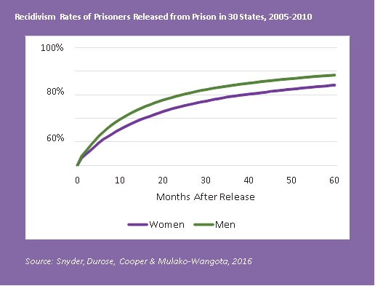
Recidivism Rates for Women
Graphic from Fact Sheet , National Center for Justice Involved Women, 2016

Slide 26
Source: National Center for Justice Involved Women, 2016

Slide 27
Getting it Right
Building systems that deflect women from the criminal justice system to the behavioral health and social service systems.
Using GR assessment instruments and classification systems
Building and staffing women’s institutions in GR ways.
Offering Evidence Based GR programs
Using GR Case Management strategies
Developing relevant and detailed re-entry plans that can be supported in the community
Promoting relational models of recovery
Continually assessing the resource a woman has to meet her and her children’s needs
HONOR HER STRENGTH AND KEEP BUILDING!

Slide 28
Evidence-Based Resources for Women’s Treatment
Forever Free
Seeking Safety
Helping Women Recover
Moving On
Healthy Relationships
Family Connections

Slide 29
Additional Resources
There are numerous resources available from the National Resource Center on Justice Involved Women that provide guidance and research on gender responsive approaches with women.
http://cjinvolvedwomen.org/
The National Registry of Evidence Based Practices (NREPP) includes resources for Women’s Programs and Practices. https://www.samhsa.gov/nrepp

Slide 30


Slide 31
Questions?
Type your question in the Q&A box
on your computer screen
Speaker Contact Info
Lisa Talbot Lundrigan ltalbotlundrigan@gmail.com
Michelle Alsup & Janine Belliti malsup@eccf.com
Tommie Bower teabower@gmail.com

Slide 32
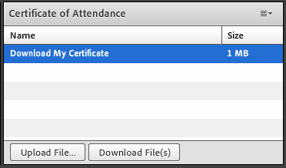
Certificate of Attendance
Download now!

Slide 33
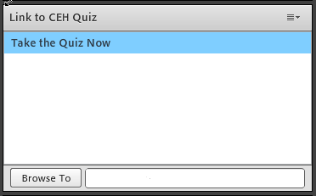
Continuing Education Hours
1 NAADAC CEH
Pass 10-question quiz with 7 correct answers
Receive certificate immediately

